Slide 1


CTI – Printout Purchase Order
Solution Design Guide
Author | Louis
Creation Date | 26-April-2021
Last Update | -
Document Ref | -
Ver. | 1.0
Antonius Wimawan
Yanuar Nukhan Wijayanto

Slide 2

CTI – Printout Purchase Order
Louis Darmawan
April 26, 2021

Slide 3
Background
Citramasjaya Teknikmandiri requires an Purchase Order template according to the Purchase Order Transaction.

Slide 4
Objective
To show invoice templates consisting of buyers and sellers based on templates provided by Citramasjaya Teknikmandiri

Slide 5
Standard NetSuite Printout Invoice

Slide 6
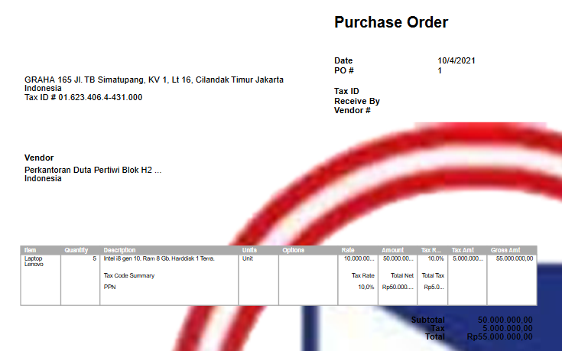
Standard Printout Purchase Order NetSuite

Slide 7
Existing Printout

Slide 9
Requirement to SDG

Slide 11
Requirement
To design the invoice template above, it takes several steps, namely :
Create new template/custom Printout Invoice
Step : Customization → Advanced PDF/HTML Template
Add New Template for Citramasjaya Teknikmandiri Standard Printout Purchase Order Form.
Adjust the fields in the invoice printout template. There are several fields that must be entered by Source :
<Vendor Name> : Vendor Name
<Valamat> : Vendor Address
<Vtelp> : Vendor Phone
<Vfax> : Vendor Fax
<Contact name> : Contact Name
<Cphone> : Contact Phone
<Cemail> : Contact Email

Slide 12
Requirement (cont.)
Cont. :
<Document Number> : Purchase Order Document Number
<Date> : Purchase Order Date
<Page> : Page
<Set by> : Person In Charge
<Currency> : Currency used
<Category> : Category Item
<Tax> : Clasification Tax
<Class> : Job Order number and Initial Location
<Revision> : Amount Revision that already Done
<Item> : Item Code
<Description> : Item Description

Slide 13
Requirement (cont.)
Cont. :
<Quantity> : Quantity of item
<UM> : Unit of Measurement of items
<Rate> : Price/units
<Amount> : Total of Price [Rate*Quantity]
<Total Amount> : Total price of all Items
<Tax AMT> : Vat Tax
<Tot AMT + Tax AMT> : Sub Total + VAT
<Remark> : Memo for the transaction
<Terbilang=English> : Description Amount in English
<Long text> : Additional Information

Slide 14
Requirement (cont.)
Cont. :
Other Information beside the source of the transaction Form is Hardcode

Slide 15
Notes
Please advice the possibility to develop this prototype scenario and possibility to be demonstrated to customer
Please advice that other item transaction will not be impacted or i should provide separate demo account

